Slide 1
ENGR90037 CAPSTONE
Commercialisation and Financial Analysis (Part 2)
Lectures 6
Yimin & Bagus

Slide 2
Learning objectives
• Previous lecture we learned actual cash flow analysis, and how to identify
Break even, Payback time, Funding requirement
• This week, we take consideration of time factors.
Discounted cash flow analysis (DCF)
• How to calculate net present value (NPV), and internal rate of return (IRR)
ENGR90037 Capstone · Lectures 5-6: Commercialisation and Financial Analysis
1

Slide 3

$10,000 Today vs. $10,000 in five years
• Do you prefer receive $10,000 Australia dollar today, or $10,000 Australia dollar in five years?
Photo by Selensergen on dreamstime
ENGR90037 Capstone · Lectures 5-6: Commercialisation and Financial Analysis
29

Slide 4
Why $10,000 in five years is not $10,000 today
• Time value - money in your hand can be put to work immediately
• Monetary Inflation – money supply grows faster than good/service production
• Cost escalation – the same $100 buys less in five years than it does now
• Risk - a future payment might not arrive at all
• So a future amount must be discounted to compare it with money today
ENGR90037 Capstone · Lectures 5-6: Commercialisation and Financial Analysis
29

Slide 5
Two directions
• Rate of return looks forward from today. Invest $100, get $105 next year - that is 5%
• Discount rate looks backward from the future. It is the rate used to shrink future money to today
• They are the same trade seen from two ends.
Rate of return
$100
$105
Current
Year 1
Discount rate
ENGR90037 Capstone · Lectures 5-6: Commercialisation and Financial Analysis
30

Slide 6
The discount factor
• The discount factor is just a multiplier:
DF = 1 / (1 + r)ⁿ
r is the discount rate
n is the number of periods
• At r = 10%: one year out DF = 0.909, five years out DF = 0.621, eight years out DF = 0.467
• Further away means a smaller factor - the future shrinks faster
ENGR90037 Capstone · Lectures 5-6: Commercialisation and Financial Analysis
31

Slide 7
Formula for calculating present value
• Present value = Future value × discount factor
• or equivalently, Present value = Future value / (1 + r)ⁿ
• r = the discount rate per period
• n = the number of periods
ENGR90037 Capstone · Lectures 5-6: Commercialisation and Financial Analysis
32

Slide 8

Example
• If I ask you if you could buy me a coffee today and I will pay you back with $100, one hundred years later.
• What is the present value (PV) of the $100 in the future? At 5% annual return
Example from Bob
ENGR90037 Capstone · Lectures 5-6: Commercialisation and Financial Analysis
33

Slide 9

Example
• Leonardo da Vinci, painter of the
Mona Lisa, died in 1519. If he instead of spending his money to buy canvas, frame, paints, he deposited $1 into a bank (hypothetical perfectly secure) paying 5% per year, how much would that grow to from 1519 to 2019 (assuming no withdrawals or
deposits in the intervening years)?
• Is the Mona Lisa worth more or the $1 worth more.
Example from Bob
ENGR90037 Capstone · Lectures 5-6: Commercialisation and Financial Analysis
33

Slide 10
Example
• If someone asks to borrow $100 and promises $108 in one year
• You could instead put it in the bank at 5% - that is your opportunity cost, so r = 5%
• What is the present value of this deal?
• Discount factor = 1 / (1 + 0.05)¹ = 0.9524
• Present value = 108 × 0.9524 = $102.86
• You pay $100 today for something worth $102.86 today. You are about $2.86 better off
ENGR90037 Capstone · Lectures 5-6: Commercialisation and Financial Analysis
33

Slide 11
How “r” is interpreted by company
• A company's starting point is its cost of capital - the blended cost of its debt and equity
• Then add a risk premium.
• Venture capital rates of 30-40% are not greed - most of the portfolio returns nothing
• "r" isn't a property of the cash flow itself - it's the return demanded by whoever is entitled to that cash flow.
34

Slide 12
Example – How “r” can be interpreted differently
Imagine you launch a business that requires a total investment of $500,000. To fund it, you borrow $400,000 from a bank at a 5% interest rate and contribute $100,000 of your own money as equity. Because you carry the residual risk of the business, you require a 12% rate of return on your personal investment.
The Lender's Perspective (Cost of Debt):
If the bank is conducting a financial analysis to approve this loan, what is their expected rate of return, and why?
The Investor's Perspective (Cost of Equity):
If you are conducting a financial analysis focusing strictly on the cash distributions you receive personally as the owner after paying off the bank, what discount rate should you use?
The Entity's Perspective (WACC):
If you are conducting a financial analysis of the entire business project as a whole, evaluating if the total operating profits can support both the debt and equity funding, what discount rate should you use?
34

Slide 13


Example – How “r” can be interpreted differently
Imagine you launch a business that requires a total investment of $500,000. To fund it, you borrow $400,000 from a bank at a 5% interest rate and contribute $100,000 of your own money as equity. Because you carry the residual risk of the business, you require a 12% rate of return on your personal investment.
The Entity's Perspective (WACC):
If you are conducting a financial analysis of the entire business project as a whole, evaluating if the total operating profits can support both the debt and equity funding, what discount rate should you use?
$$WACC=\left(Cost of Debt × Weight of Debt\right)+(Cost of Equity × Weight of Equity)$$
$WACC=(5\% × 80\%)$ + (12% $×$ 20%)
$$WACC=6.4\%$$
34
Note: Corporate tax is ignored in this introductory model to simplify the calculation.

Slide 14
From one payment to a stream - NPV
• The friend example discounted one future amount. A project has a column of them
• Discount every period's net cash flow by its own factor, then add them all up
• That total is the net present value - the value the project adds, in today's money
• NPV > 0 - worth more than the alternative you priced into r
• NPV < 0 - you would be better off doing the alternative
ENGR90037 Capstone · Lectures 5-6: Commercialisation and Financial Analysis
35

Slide 15
How long do we study?
• The study period is how far into the future you forecast. It is a decision you must justify
• It has to cover development, launch, and enough trading to show the venture
• Longer periods carry more uncertainty - and discounting makes distant years matter less anyway
• At the end, count the salvage value - what the assets are worth when you stop
• Salvage can be negative: decommissioning, site remediation, disposal
ENGR90037 Capstone · Lectures 5-6: Commercialisation and Financial Analysis
36

Slide 16
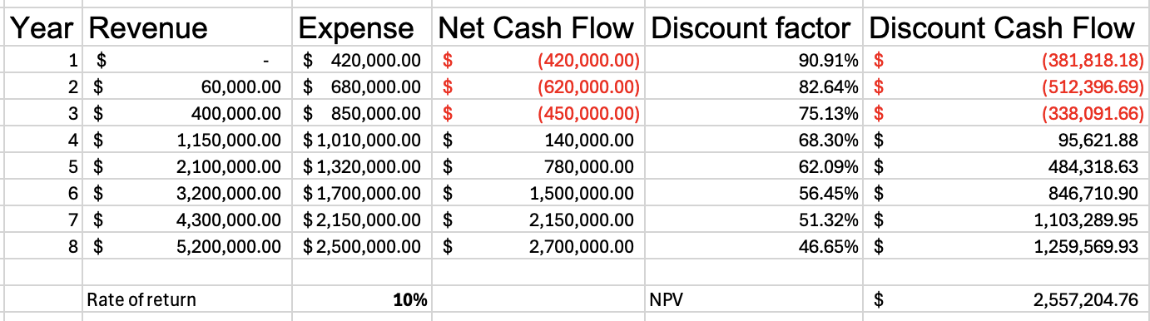
4. Net present value - example
• Same eight cash flows as week 5. Two new columns. r = 10%
• Year 1 means the end of year 1. So n = 1.
• NPV = $2,557,204 - the venture adds $2.6 million in today's money, at 10%
• The early negatives barely shrink. The late positives shrink a lot
Last week, the cumulative cash flow was 5.78M.
ENGR90037 Capstone · Lectures 5-6: Commercialisation and Financial Analysis
37

Slide 17
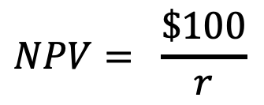
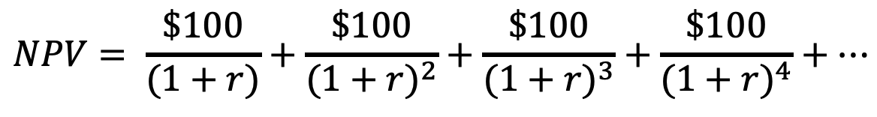
Example – the net present value of a Perpetuity
• A perpetuity is a constant cash flows that continues forever with no end date.
• If you receive $100 dollar every year, with r as the rate of return, first payment at the end of year 1, what is the present value?
$$NPV= \frac{\$100}{(1+r)}+\frac{\$100}{{(1+r)}^{2}}+\frac{\$100}{{(1+r)}^{3}}+\frac{\$100}{{(1+r)}^{4}}+⋯$$
$$NPV= \frac{\$100}{r}$$
ENGR90037 Capstone · Lectures 5-6: Commercialisation and Financial Analysis
36

Slide 18

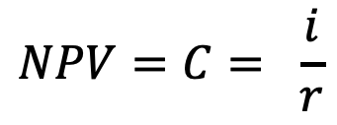
Example – the net present value of a Perpetuity
• If you deposit amount of money C into the bank with interest rate of r.
• At the end of each year, you withdraw the interest i, and keep the initial investment C in the bank.
• In this case, you can withdraw ”i” money from the bank forever.
• So, you ”lose” the initial investment C, and you receive a constant payment of i forever.
$$i=C × r$$
$$NPV=C= \frac{i}{r}$$
ENGR90037 Capstone · Lectures 5-6: Commercialisation and Financial Analysis
36

Slide 19
5. Internal rate of return (IRR)
• The IRR is the value of "r" at which the NPV equals zero
• The rate at which the project exactly breaks even against its alternative
• It is the project's own return, expressed as a percentage per year
ENGR90037 Capstone · Lectures 5-6: Commercialisation and Financial Analysis
38

Slide 20
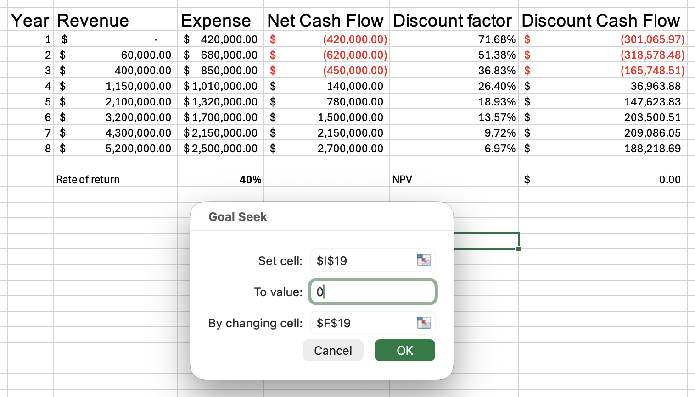
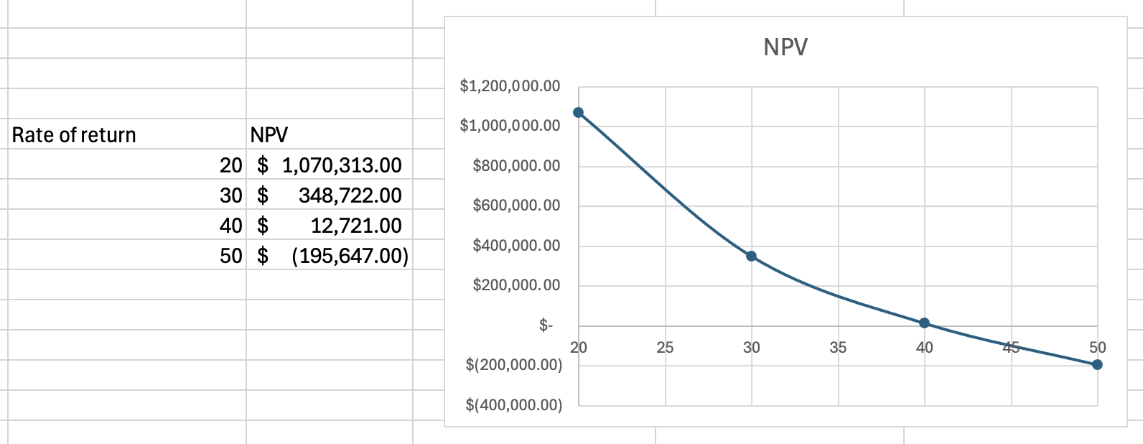
Finding the IRR – Demonstration
• In Excel: Goal Seek - set the NPV cell to 0 by changing the rate cell
• By hand: trial and error - try different rates and check the NPV each time
ENGR90037 Capstone · Lectures 5-6: Commercialisation and Financial Analysis
39

Slide 21
NPV or IRR?
• You have both. As an investor, which one do you decide on?
• NPV tells you how much value - in dollars. It is the better decision rule
• IRR tells you how efficiently - per dollar, per year. Better for comparing unequal things
• They can disagree: a big project with a modest IRR often beats a small one with a huge IRR
• In practice: rank by NPV, screen with IRR against a hurdle rate, and when capital is limited, take the best IRRs until the money runs out
ENGR90037 Capstone · Lectures 5-6: Commercialisation and Financial Analysis
40

Slide 22
The do-nothing baseline
• Every proposal is compared with something. Sometime it can also be compared with doing nothing
• Doing nothing is rarely free - assets still age, competitors still move, complaints still arrive
• For the council: not surveying roads is not a $0 option. It is deferred maintenance and worse potholes
• So the honest question is not what does this project cost but what is the difference between the two futures
ENGR90037 Capstone · Lectures 5-6: Commercialisation and Financial Analysis
41

Slide 23
Sensitivity analysis
• Which assumption is the decision resting on?
• Sensitivity analysis - change one assumption, see what moves
• How NPV and IRR change with:
• Revenue -10%, or +10%
• Costs -10%, or +10%
ENGR90037 Capstone · Lectures 5-6: Commercialisation and Financial Analysis
43

Slide 24
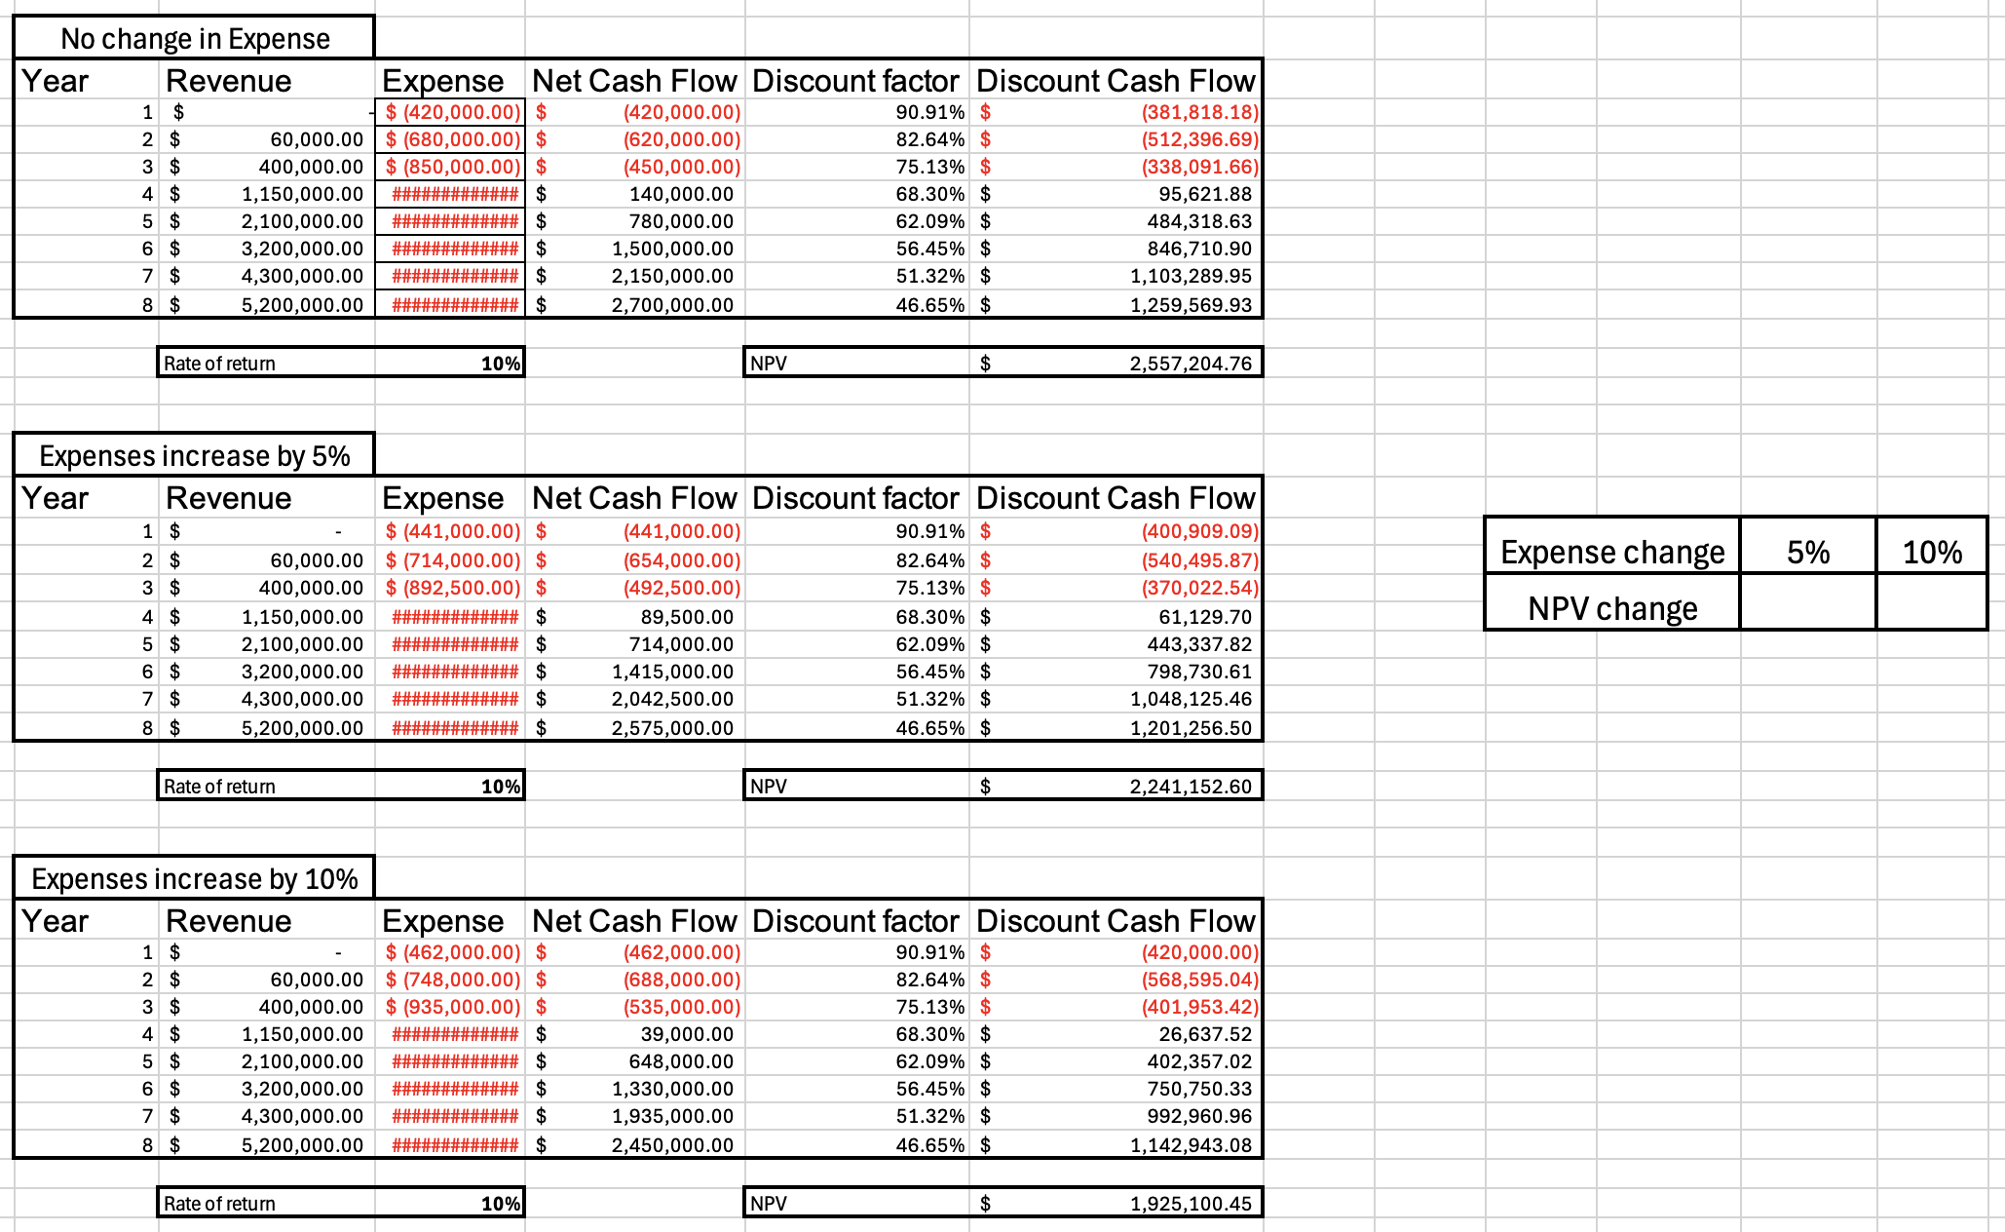
Sensitivity analysis - Demonstration
ENGR90037 Capstone · Lectures 5-6: Commercialisation and Financial Analysis
43

Slide 25
When the value is not money
• Back to week 5: value is multidimensional. This block priced one dimension
• Public, research and not-for-profit projects deliver value that will not take a dollar sign
• Cost-effectiveness is the usual substitute: fixed benefit, lowest cost - or fixed budget, most benefit
ENGR90037 Capstone · Lectures 5-6: Commercialisation and Financial Analysis
45

Slide 26
Intellectual Property (IP)
• IP is critical for commercialisation. Without it, nothing stops a competitor copying you.
• Apply, pay, get registered with IP Australia: it can include patents, trade marks, design rights, plant breeder's rights
• Each registered right has a different term, renewal cycle and cost: patents 20 yrs, trade marks 10 yrs but renewable forever, designs 10 yrs max
• Registered rights are territorial. An Australian patent stops nobody in other countries.
• Your capstone: if you have an industry partner, an agreement already governs who owns what. Find out before you disclose anything publicly
ENGR90037 Capstone · Lectures 5-6: Commercialisation and Financial Analysis
45

